Slide 1

Treeception: the Tree of Infinite Levels
By Joshua Ross

Slide 2
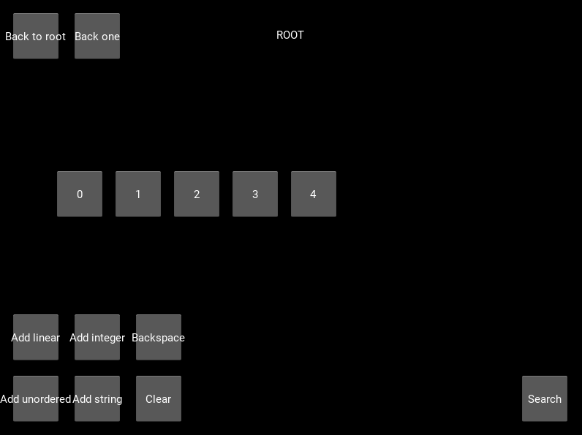
Introduction
Treeception is a visualization of a tree with virtually infinite levels! (It can be finite, but this is mathematically rare.)
The top-middle text shows what node you are looking at, and the top-left buttons allow you to return to the lower levels.
The middle buttons represent the node's children and can be clicked on to view that node and its children.
The buttons in the bottom row allow you to utilize the Chain Search feature. (more on that in a later slide)
The example to the right is a visualization of the root node.

Slide 3
Types of Nodes and Children
There are four different types of nodes: linear, unordered, integer, and string nodes.
Linear nodes are nodes whose children are ordered and labelled with numbers, like a linear collection.
Unordered nodes are nodes whose children are randomly positioned on the screen and labelled with random letters so that they don't appear to have an order, like an unordered collection.
Integer and string nodes are nodes with no children, but instead are assigned with random four-digit integer and string values, respectively.
While viewing these nodes, their values are displayed in the top-right.
Each node has a 60% chance of being linear or unordered, and 40% chance of being an integer or string.
Each linear and unordered node has anywhere from one to five children.
The root node is always a linear node with five children. This is to dwindle the tree's chances of being finite.

Slide 4
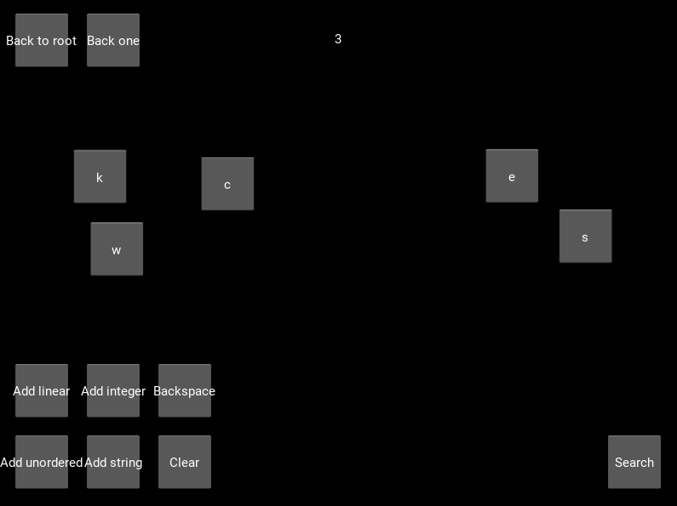
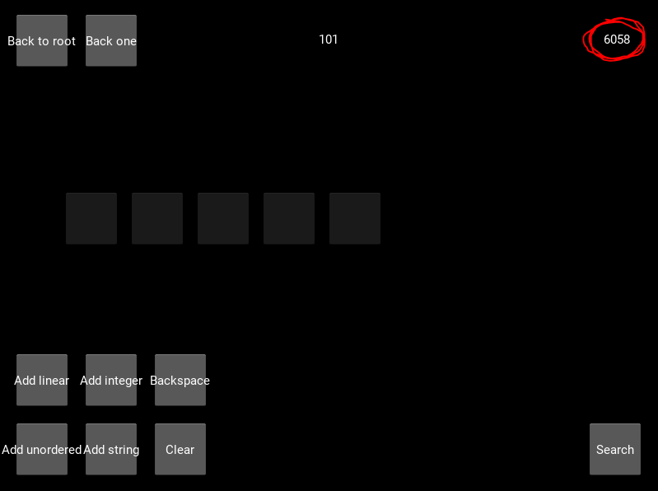
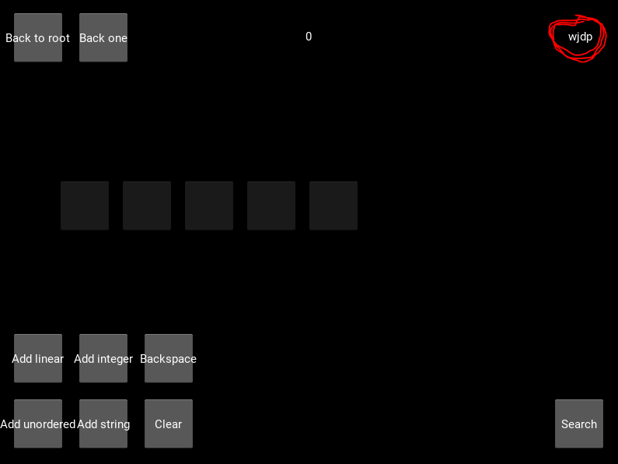
An unordered node (top), an integer node (left), and a string node (right). The integer and string values are circled.
Notice based on the directories that all three of these nodes are descended from linear nodes. Descendants of unordered nodes are indicated in the directory with their corresponding letters.

Slide 5
GitHub Commits
Initial Commit: The first commit; introduces the software's core functionality, which includes the tree itself, visualization, navigation, and the different types of nodes
Chain Search: Introduces the Chain Search mechanic (more on that in the next slide)
Polish: Simply updates the code to conform with the PEP8 style guide
Presentation: If it exists as a separate commit, then that's the one where this presentation was introduced.

Slide 6
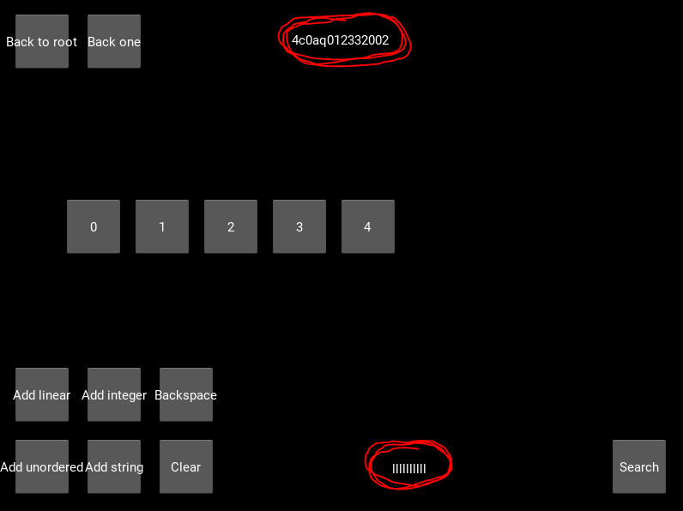
Chain Search
Chain Search is a feature where you can search for certain types of nodes in a chain, or sequence. For example, you can find a string node within an unordered node within a linear node within another unordered node!
The search is relative to the node you are viewing when you initiate the search, so if you wish to search the entire tree, then return to the root node first.
On the off-chance that no such chain is found, a sound will go off and you will be sent back to the root node.
The buttons on the bottom row can be used to utilize this feature.
The four "Add" buttons add a node to the chain, whose type corresponds to the button clicked.
Only the last node in the chain can be an integer or string node, since they don't have any children with which to continue the chain.
"Backspace" removes the last node from the chain, and "Clear" clears the entire chain.
"Search" begins the search for the given chain of nodes. When finished, the last node in the chain will be summoned for viewing.
The other six buttons are disabled during the search, but you can click this button again to abort the search.
Chain Search uses breadth-first traversal to find the desired chain closest to the origin. Depth-first traversal would be foolish since the tree is infinite.
In the example to the right, I searched for ten linear nodes in a row. There are only nine numbers in a row in the directory, but the node labelled 'q' is also a linear node. It is labelled with a letter because its parent is an unordered node.

